Slide 1

CS 188: Artificial Intelligence
Reinforcement Learning I
Instructor: Stuart Russell and Dawn Song
University of California, Berkeley
Notes:
Please retain proper attribution, including the reference to ai.berkeley.edu. Thanks!

Slide 2
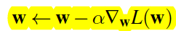
Recap: Gradient Descent
Loss function L(w), weight update:
Quiz: for same learning rate, which case will have a bigger update of w:
A: a big loss at w
B: a big gradient for L at w

Slide 3
Recap: Backprop
f
j
h
g
k
Notes:
Write forward pass, backward pass
L;

Slide 4
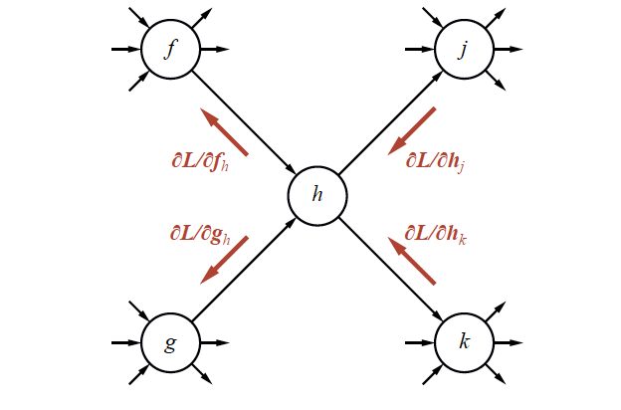
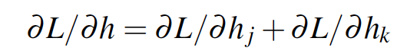
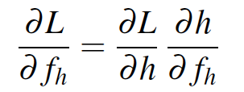
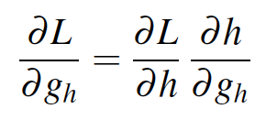
Recap: Backprop

Slide 5

Reinforcement Learning

Slide 6





Markov Decision Process (MDP)
An MDP is defined by:
A set of states s ∈ S
A set of actions a ∈ A
A transition model T(s, a, s’)
Probability that a from s leads to s’, i.e., P(s’| s, a)
A reward function R(s, a, s’) for each transition
A start state
Possibly a terminal state (or absorbing state)
Utility function which is additive (discounted) rewards
MDPs are fully observable but probabilistic search problems
[Demo – gridworld manual intro (L8D1)]
Notes:
In search problems: did not talk about actions, but about successor functions --- now the information inside the successor function is unpacked into actions, transitions and reward
Write out S, A, example entry in T, entry in R
Reward function different from the book : R(s,a,s’)
In book simpler for equations, but not useful for the projects.
Need to modify expectimax a tiny little bit to account for rewards along the way, but that’s something you should be able to do, and so you can already solve MDP’s (not in most efficient way)

Slide 7
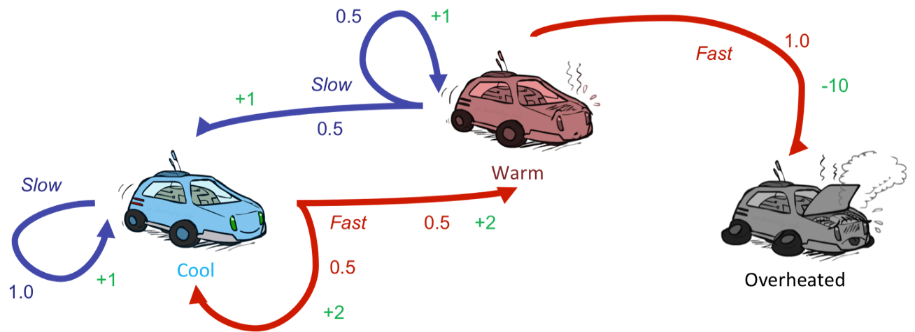
Reinforcement Learning
Still assume a Markov decision process (MDP):
A set of states s ∈ S
A set of actions (per state) A
A model T(s,a,s’)
A reward function R(s,a,s’)
Still looking for a policy π(s)
New twist: don’t know T or R
I.e. we don’t know which states are good or what the actions do
Must actually try actions and states out to learn

Slide 8
Reinforcement Learning
Agent
State: s
Reward: r
Actions: a
Environment
Basic idea:
Receive feedback in the form of rewards
Agent’s utility is defined by the reward function
Must (learn to) act so as to maximize expected rewards
All learning is based on observed samples of outcomes!

Slide 9
Reinforcement learning
Basic ideas:
Exploration: you have to try unknown actions to get information
Exploitation: eventually, you have to use what you know
Sampling: you may need to repeat many times to get good estimates
Generalization: what you learn in one state may apply to others too

Slide 10
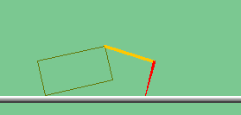
The Crawler!
Notes:
Hard because at times it gets not reward as it is repositioning its arm

Slide 11

Video of Demo Crawler Bot

Slide 12
DeepMind Atari (©Two Minute Lectures)

Slide 13
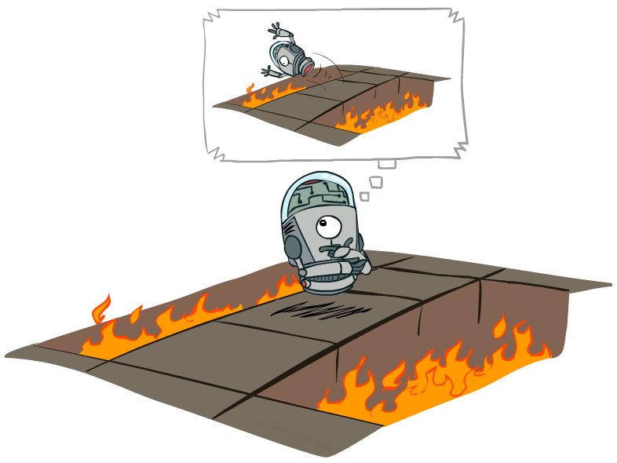
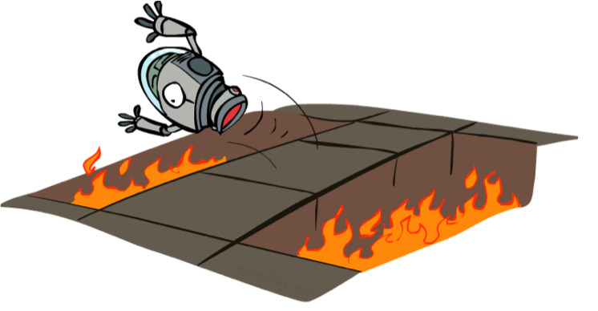
Offline (MDPs) vs. Online (RL)
Offline Solution
Online Learning

Slide 14
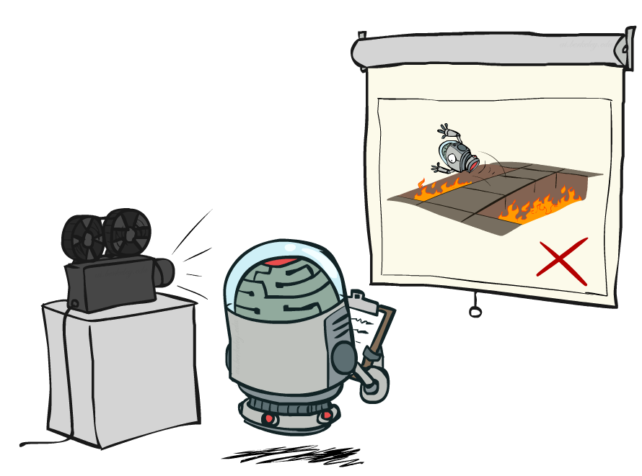
Passive Reinforcement Learning

Slide 15

Model-Based Learning

Slide 16

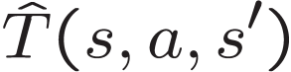

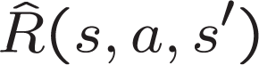
Model-Based Learning
Model-Based Idea:
Learn an approximate model based on experiences
Solve for values as if the learned model were correct
Step 1: Learn empirical MDP model
Count outcomes s’ for each s, a
Normalize to give an estimate of
Discover each when we experience (s, a, s’)
Step 2: Solve the learned MDP
For example, use value iteration, as before

Slide 17
Example: Model-Based Learning
Input Policy π
Observed Episodes (Training)
Learned Model
Episode 1
Episode 2
T(s,a,s’).
T(B, east, C) = 1.00
T(C, east, D) = 0.75
T(C, east, A) = 0.25
…
R(s,a,s’).
R(B, east, C) = -1
R(C, east, D) = -1
R(D, exit, x) = +10
…
 | A
B | C | D
 | E
B, east, C, -1
C, east, D, -1
D, exit, x, +10
B, east, C, -1
C, east, D, -1
D, exit, x, +10
Episode 3
Episode 4
E, north, C, -1
C, east, D, -1
D, exit, x, +10
E, north, C, -1
C, east, A, -1
A, exit, x, -10
Assume: γ = 1

Slide 18
Pros and cons
Pro:
Makes efficient use of experiences
Con:
May not scale to large state spaces
Learns model one state-action pair at a time (but this is fixable)
Cannot solve MDP for very large |S|

Slide 19
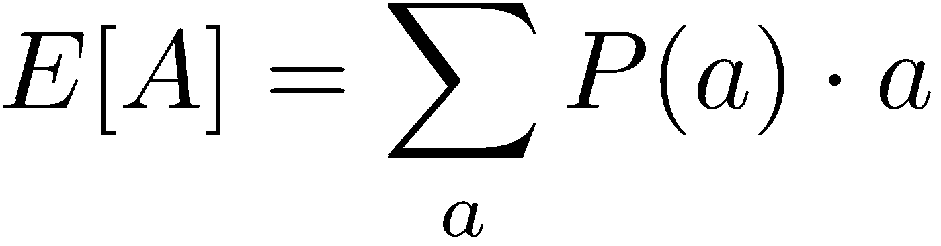
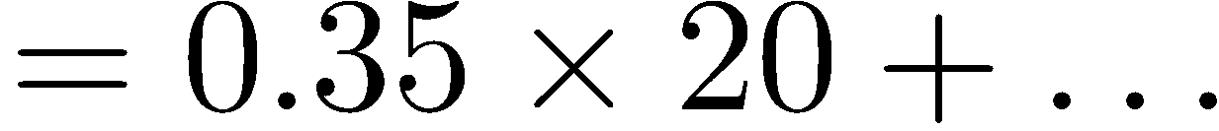
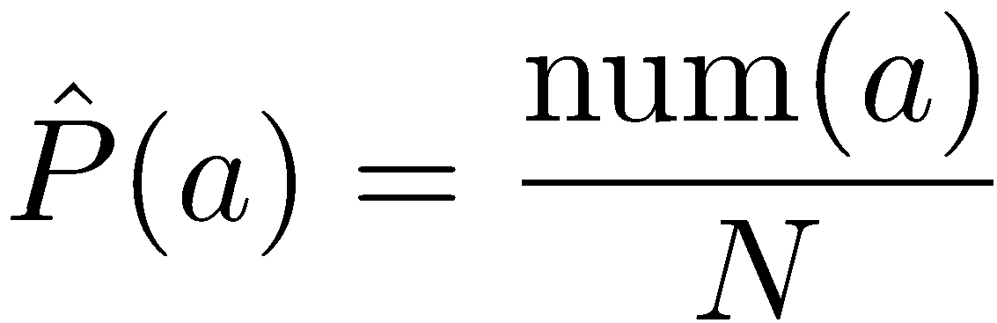
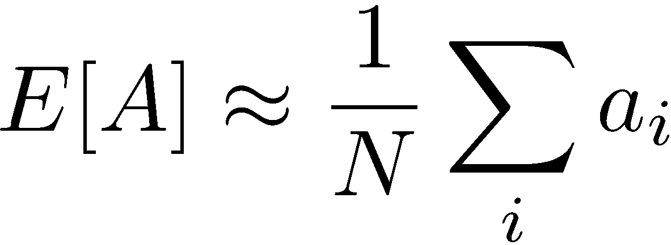
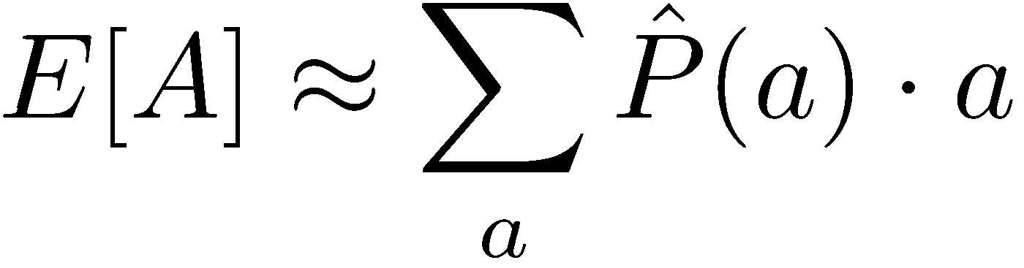
Analogy: Expected Age
Goal: Compute expected age of cs188 students
Known P(A)
Without P(A), instead collect samples [a₁, a₂, … a_{N}]
Unknown P(A): “Model Based”
Unknown P(A): “Model Free”
Why does this work? Because eventually you learn the right model.
Why does this work? Because samples appear with the right frequencies.

Slide 20
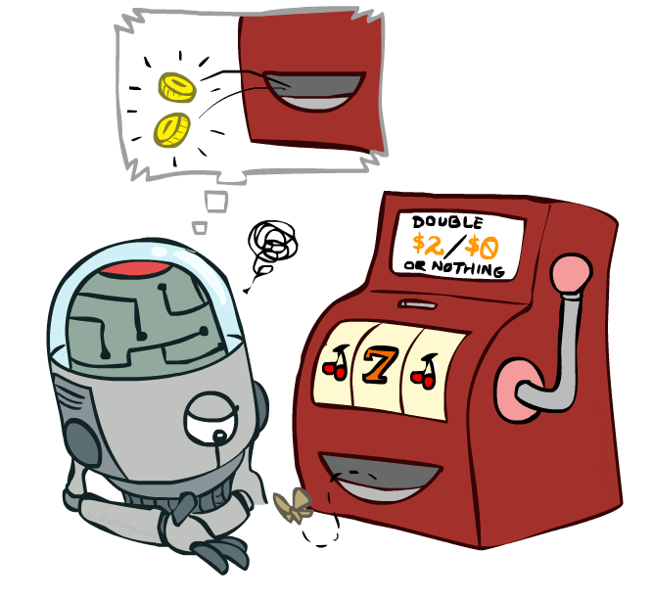
Model-Free Learning

Slide 21

Passive Reinforcement Learning
Simplified task: policy evaluation
Input: a fixed policy π(s)
You don’t know the transitions T(s,a,s’)
You don’t know the rewards R(s,a,s’)
Goal: learn the state values
In this case:
Learner is “along for the ride”
No choice about what actions to take
Just execute the policy and learn from experience
This is NOT offline planning! You actually take actions in the world.

Slide 22
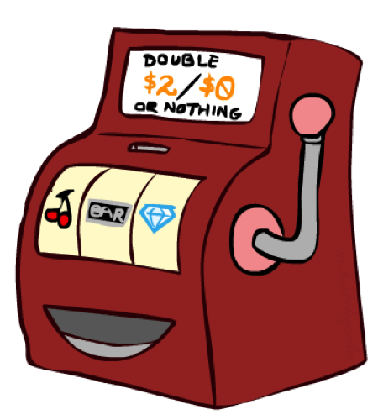
Direct Evaluation
Goal: Compute values for each state under π
Idea: Average together observed sample values
Act according to π
Every time you visit a state, write down what the sum of discounted rewards turned out to be
Average those samples
This is called direct evaluation

Slide 23
Example: Direct Evaluation
Input Policy π
Observed Episodes (Training)
Output Values
Episode 1
Episode 2
 | A
B | C | D
 | E
 | A
B | C | D
 | E
B, east, C, -1
C, east, D, -1
D, exit, x, +10
B, east, C, -1
C, east, D, -1
D, exit, x, +10
-10
+8
+4
+10
Episode 3
Episode 4
-2
E, north, C, -1
C, east, D, -1
D, exit, x, +10
E, north, C, -1
C, east, A, -1
A, exit, x, -10
If B and E both go to C under this policy, how can their values be different?
Assume: γ = 1

Slide 24
Problems with Direct Evaluation
What’s good about direct evaluation?
It’s easy to understand
It doesn’t require any knowledge of T, R
It eventually computes the correct average values, using just sample transitions
What bad about it?
It wastes information about state connections
Each state must be learned separately
So, it takes a long time to learn
Output Values
 | A
B | C | D
 | E
-10
+8
+4
+10
-2
If B and E both go to C under this policy, how can their values be different?

Slide 25

Why Not Use Policy Evaluation?
s
Simplified Bellman updates calculate V for a fixed policy:
Each round, replace V with a one-step-look-ahead layer over V
This approach fully exploited the connections between the states
Unfortunately, we need T and R to do it!
Key question: how can we do this update to V without knowing T and R?
In other words, how to we take a weighted average without knowing the weights?
π(s)
s, π(s)
s, π(s),s’
s’

Slide 26
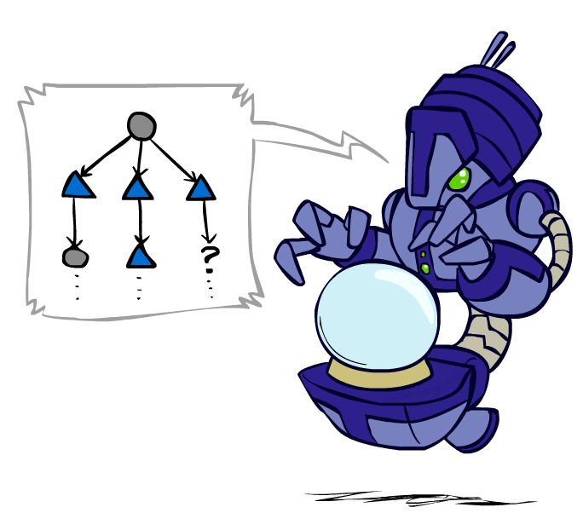
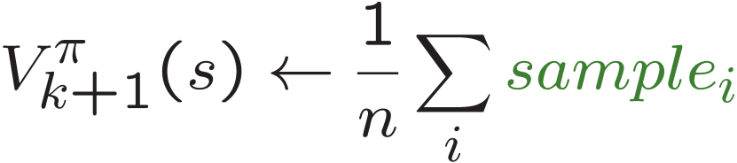
Sample-Based Policy Evaluation?
We want to improve our estimate of V by computing these averages:
Idea: Take samples of outcomes s’ (by doing the action!) and average
s
π(s)
s, π(s)
s, π(s),s’
s₁'
s₂'
s'
s₃'
Almost! But we can’t rewind time to get sample after sample from state s.
Notes:
If we could do this, we would be implementing the policy evaluation update;
We cannot rewind all the time to restart at s

Slide 27
Temporal Difference Learning
Big idea: learn from every experience!
Update V(s) each time we experience a transition (s, a, s’, r)
Likely outcomes s’ will contribute updates more often
Temporal difference learning of values
Policy still fixed, still doing evaluation!
Move values toward value of whatever successor occurs: running average
s
π(s)
s, π(s)
s’
Sample of V(s):
Update to V(s):
Same update:

Slide 28
Exponential Moving Average
Exponential moving average
The running interpolation update:
Makes recent samples more important
Forgets about the past (distant past values were wrong anyway)
Decreasing learning rate (alpha) can give converging averages
Notes:
More recent samples are better because the estimates for vk are better

Slide 29
Example: Temporal Difference Learning
States
Observed Transitions
B, east, C, -2
C, east, D, -2
 | A
B | C | D
 | E
 | 0
0 | 0 | 8
 | 0
 | 0
-1 | 0 | 8
 | 0
 | 0
-1 | 3 | 8
 | 0
Assume: γ = 1, α = 1/2

Slide 30
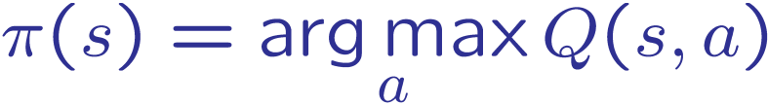
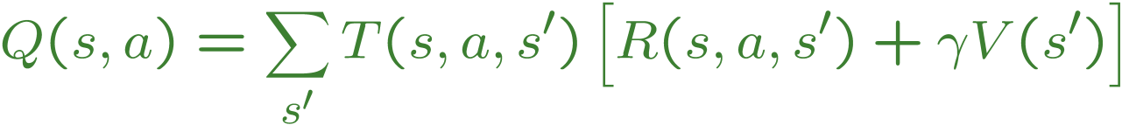
Problems with TD Value Learning
TD value leaning is a model-free way to do policy evaluation, mimicking Bellman updates with running sample averages
However, if we want to turn values into a (new) policy, we’re sunk:
Idea: learn Q-values, not values
Makes action selection model-free too!
s
a
s, a
s,a,s’
s’

